Slide 2
LabVIEW Image Editor Framework (LIEF) Early Bird Intro
Eric Maussion – Staff AES

Slide 3
Topics
Original Need
State of the Art
LIEF Components
Image constraints
Forms
Editor Handler
LIEF Use Cases
Take Away

Slide 4
Original Need
From Customers:
“I want a didactic editor to configure my system.”
“I want to create forms in order to draw a schematic.”
“I want a graphical overview of my system/configuration.”
“I want to dynamically create items.”
Conclusions:
Customers are lazy.
Provide an easy and extendable way to dynamically interact with objects on a user interface.

Slide 5
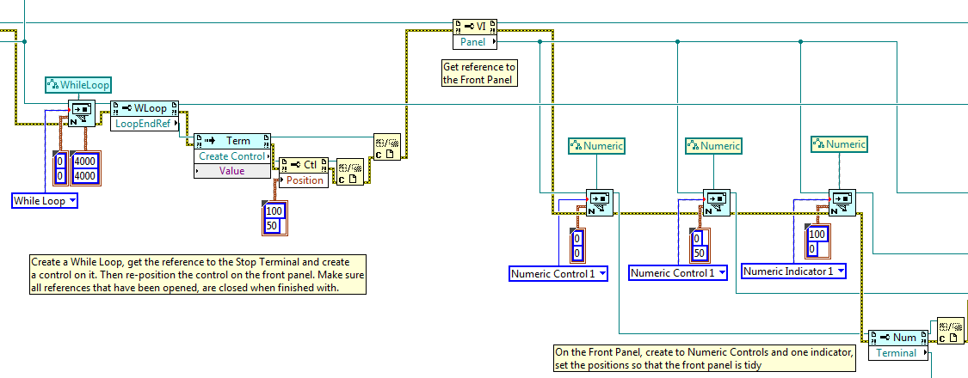
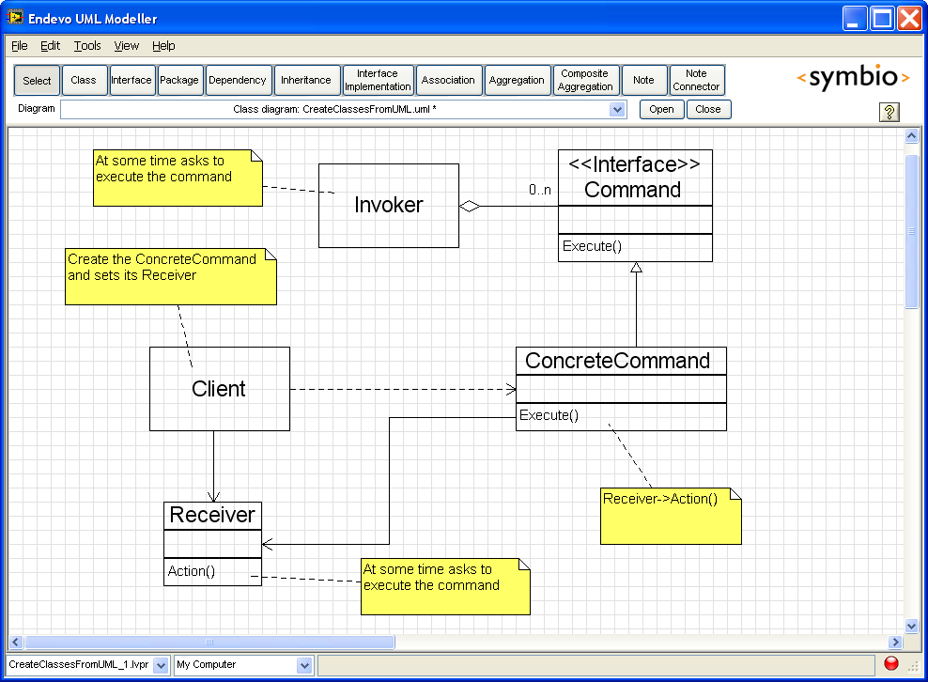
State of the Art
Doable with CVI, WPF, WinForms, Java, Web (HTML, PHP, ASP.NET…)
LabVIEW…?
VI Server/Scripting?
GOOP?

Slide 6
LabVIEW Image Editor Framework (LIEF) Requirements
Remember:
Provide an easy and extendable way to dynamically interact with objects on a user interface.
Use a 2D Picture as a surface
Encapsulate all the basic interactions with the surface and its objects into one VI
Create a small set of basic objects to work with
Allow extending the possible interactions, and the set of available objects
Make it as simple as possible to use and extend
Basic OOP seems reasonable?!
Provide a full-featured API

Slide 7
LIEF Demo #1

Slide 8
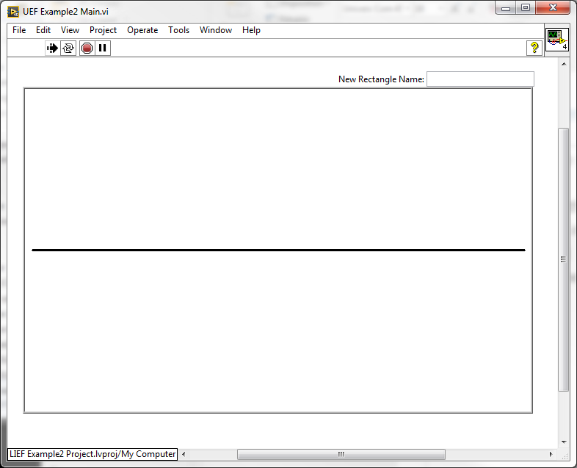
LIEF Components: Image
The LV 2D Picture needs to be a control
Allows focus!
Enable the Smooth Updates option
Otherwise the image will flicker
Remove the label
It screws up the position of the control

Slide 9
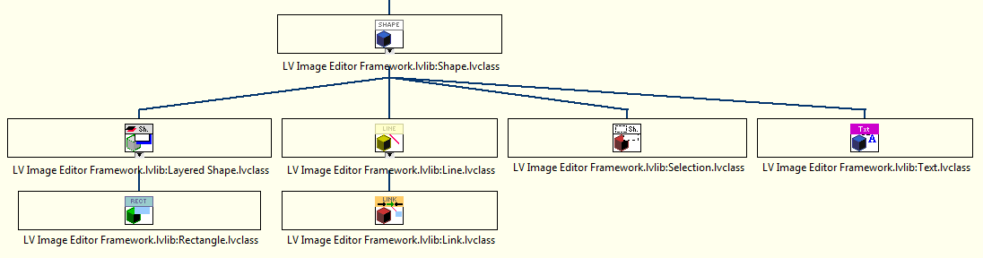
LIEF Components: Forms
Basic shapes (rectangle, text, line, link) are available
Each shape is a class, it can be inherited to allow custom shapes
It is encouraged to create new class to fit a new application need!
Layered Shape = Aggregation Pattern (a shape made of inner shapes)
Selection = Decoration Pattern (contains the true selected shape)

Slide 10
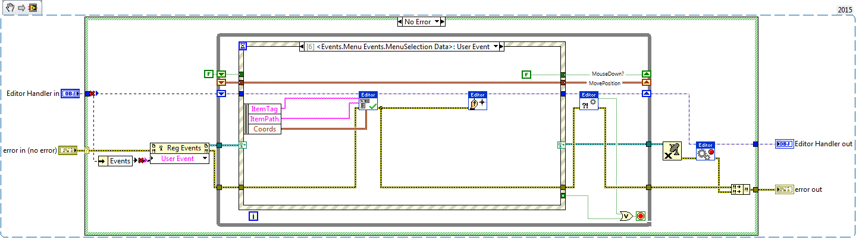
LIEF Components: Editor Handler
Asynchronous component (just like an actor)
Responsible for maintaining the image state
Heavily relies on callbacks and user events
Need callbacks to detect picture events (mouse, keyboard, menu…)
Need user events to route callbacks data to a centralized event structure, and for additional events
All the responses to events can be overridden and thus customized

Slide 11

LIEF Components: More to come…
Future Plans (days…months):
A full-featured API for the editor and the forms
Out-of-the-box examples
Complete help to gain a complete understanding of the framework
A project provider to create new forms and children editor classes from the LabVIEW project! (just like the AF)

Slide 12
LIEF Demo #2

Slide 13
LIEF Use Cases
CANView: A CAN assistant for users to visualize a CAN cluster with all its nodes. Add, configure and run XNET nodes.
SDF GMapper: Provide a graphical representation of the mappings in a VeriStand Definition File. Be able to add/edit/remove mappings from there.
Factory Manager: Create a map of a factory with all the deployed NI Systems. Access the targets configuration or monitoring UI from this centralized view. Suitable for condition monitoring sites
More ideas?

Slide 14
Take Away
LIEF can leverage new programming possibilities
LIEF can improve the end-user experience for LV applications
Don’t LIEF me alone
I need users/testers!
Next Steps:
Probe your feedbacks
Move to Beta (API, Help, satisfying test results…)
Present to a broader audience (Europe+NIC)
Publish (LVTN) & advertise (presentations, videos)

